Slide 1
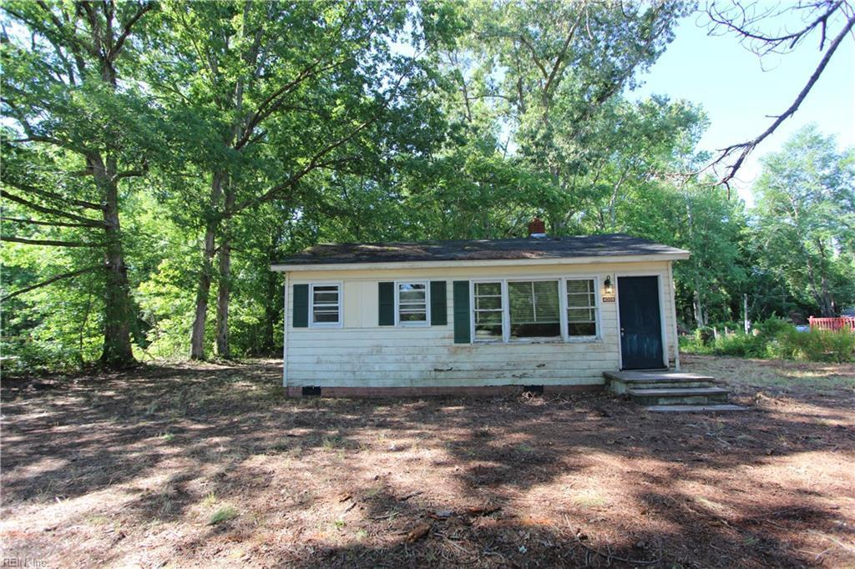
Fix/Flip or BRRR Investment Proposal
4008 Buckley Hall Rd,
Cobbs Creek, VA 23035
InteleCOM Investments LLC
Harpers Ferry, WV 25425

Slide 2
Loan Request Proposal
Purchase Price: $30,000
Purchase Costs: $2,000
Rehab Costs: $75,000.00
Total Project Costs: $109,000.00
Loan request at 100% of total project costs: $109,000.00
Proposed loan interests: 10% annual
Proposed loan terms:
Unpaid principal balance & accrued interest due on the sale of property
Proposed finance costs: $908.33 per mo*
*Subject to change based on final loan approval & terms

Slide 3
InteleCOM Investments LLC
Owner of a Telecommunications company, long time estimator and project manager specializing in new commercial construction, I will be overseeing the timeline, budget, and overall design scope of this project and will be on site weekly. If timelines are not met, I will bring my own crew on site to meet deadlines.
I have been a part of over 100 successful DAS and 2-Way RCES nationwide and a few relevant projects are listed below for quality assurance purposes.
1.Amazon- Location Undisclosed: Converged Passive Neutral Host Cellular DAS, Passive 2-Way RCES, and WiFi system
2.International Monetary Fund- NW Washington, DC: Active BTS Fed AT&T DAS
3.National’s Park- SE Washington, DC: Active BTS Fed Neutral Host Cellular DAS
4.Capital One Arena- NW Washington, DC: Active BTS Fed AT&T Cellular DAS
5.Dulles International Airport- Dulles, VA: Active BTS Fed AT&T Cellular DAS
6.11.Audi Field (DC United Stadium)- SW Washington, DC: Active Fiber Fed 2-Way RCES
Worked as a carpenter building custom homes and built a house from the ground up while in high school.
This is my first flip but I have run numbers on hundreds of projects and have already set up and scaled a marketing division strictly for finding residential single family homes at a discount. I have turned down multiple properties after I had the property under contract becuase they didn’t meet our margins after a site walk but this property does meet our strict guidelines and we want to move forward on it.

Slide 4
Property Description
2bd / 1ba cottage bungalow in a solid B- neighborhood
Adding some sq ft to the front of the house by building a bumpout that will also serve as the boarder for a front porch
Laundry/ Utility room and extra storage will be in addition built on front of house
Full unfinished attic for storage with stairs
Screened in porch added to back of house for extra space and to emphasize the views
Large lot and will have a Carport lean-to built on side of house
Right off the Chesapeake Bay
Less than 39 miles to Newport News,
Easy access to highway

Slide 5
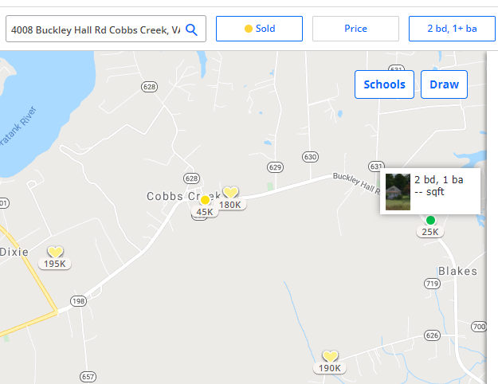
Sold Comps and Map Location

Slide 6
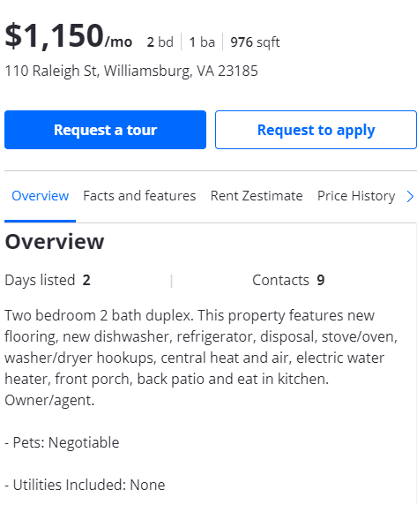
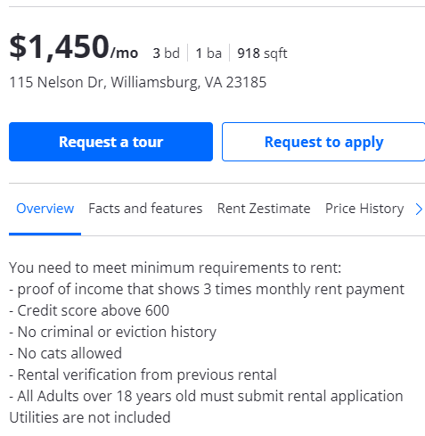
Rental Comps/ High and Low

Slide 7
Rehab Details
See attached Rehab estimate

Slide 8
Flip Financial Information
See attached Fix and Flip or Rental Estimator

Slide 9
Sold Comps
2703 Ridge Rd, Cobbs Creek, VA 23035 Sold $190K 6/28/21
3355 Buckley Hall Rd, Cobbs Creek, VA 23035 Sold $180K 6/7/21
1960 Marshall Ln, Hayes, VA 23072 Sold $190K 7/16/21
2436 Perrin Creek Rd, Hayes, VA 23072 Pending $215K Current

