Slide 1
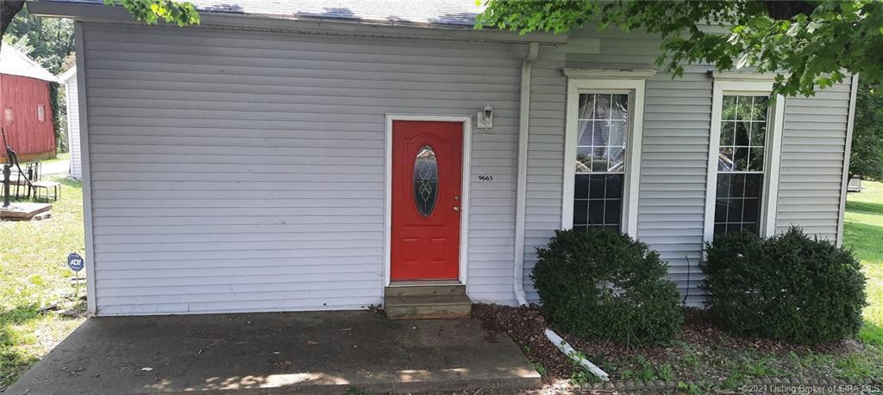
Fix/Flip or BRRR Cash Investment Proposal
9665 Hwy 150,
Greenville, IN 47124
InteleCOM Investments LLC
Harpers Ferry, WV 25425

Slide 2
Loan Request Proposal
Purchase Price: $105,000
Purchase Costs: $2,000
Rehab Costs: $25,000.00
Total Project Costs: $132,000.00
Loan request at 100% of total project costs: $132,000.00
Proposed loan interests: 2 points and 8% annual
Proposed loan terms:
Unpaid principal balance & accrued interest due on the sale of property
only for the months that the investment was used
Proposed finance costs:
4880 per mo and loan term 6 months= $5,280 + 2 points ($2100)*
*Subject to change based on final loan approval & terms

Slide 3
InteleCOM Investments LLC
Owner of a Telecommunications company, long time estimator and project manager specializing in new commercial construction, I will be overseeing the timeline, budget, and overall design scope of this project and will be on site weekly. If timelines are not met, I will bring my own crew on site to meet deadlines.
I have been a part of over 100 successful DAS and 2-Way RCES nationwide and a few relevant projects are listed below for quality assurance purposes.
1.Amazon- Location Undisclosed: Converged Passive Neutral Host Cellular DAS, Passive 2-Way RCES, and WiFi system
2.International Monetary Fund- NW Washington, DC: Active BTS Fed AT&T DAS
3.National’s Park- SE Washington, DC: Active BTS Fed Neutral Host Cellular DAS
4.Capital One Arena- NW Washington, DC: Active BTS Fed AT&T Cellular DAS
5.Dulles International Airport- Dulles, VA: Active BTS Fed AT&T Cellular DAS
6.11.Audi Field (DC United Stadium)- SW Washington, DC: Active Fiber Fed 2-Way RCES
Built a house from the ground up while in high school, and worked for a builder building custom homes
Currently renovating our first flip, purchasing our first rental, and this project in our first 6 months in business.

Slide 4
Property Description
2bd / 1ba cottage bungalow in a solid B metro neighborhood
Updting front of house and adding a window to the front of the house to the left side of the door
House is in good condition currently needs floors and paint
Full unfinished attic for storage with stairs
Detached 2 car garage makes for a possible single room apartment in the future
Large lot, deck, and above ground pool make for a great rental property
In the Louisville Metro
Easy access to highway

Slide 5
Sold Comps and Map Location

Slide 6
Rental Comps

Slide 7
Rehab Details
Flooring throughout
Some minor drywall fixes and patch/ paint throughout
Counter tops,
Updating front of house (paint trim, window addition, new light, new address numbers)
Appliances
Electrical

